Slide 1



READING
HABITS
REPORT
01.INTRODUCTION
This report presents a
personal and
introspective
examination of my
favorite hobby.
It seeks to analyze
underlying trends,
preferences and
motivations that shape
my reading experience.

Slide 2
READING
HABITS
REPORT
03.DESCRIPTION OF THE
VARIABLES
. An examination of seven
carefully selected books was undertaken.
. Some of the variables analyzed include book titles, authors’
country of origin, genres,
ratings, page counts, dates of commencement, date of
completion, book formats and time invested in reading each book.
. The authors’ country of origin was either United States or
United Kingdom.
. The genres consisted of genres such as classics, fantasy, and romance.
. The rating given to every book was between a scale of one to ten.
. The page count for all seven books ranges from 112 to 279 with the average page count being 199.
. The type of book formats used the most were physical books, audio books and electronic
books.
. The time spent reading each
book ranged from 5 hours to 40 hours. The average time spent reading all seven books was
calculated as 17.5 Hours.
02.METHODOLGY
. This research employed a qualitative approach to
analyze my reading habits.
. The data was collected
from my personal library and books app on my
iPhone.
. The data was analyzed by monitoring the reading
pace and habits over a
six-month period using
descriptive statistics such as bar graphs and pie
charts.

Slide 3
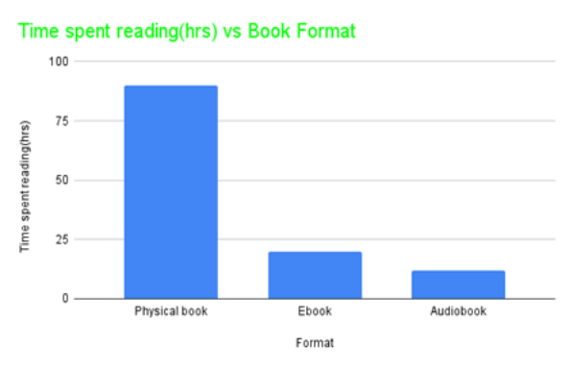
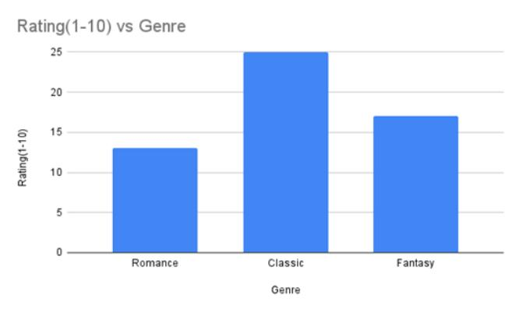
READING HABITS REPORT
04 . DATA ANALYSIS AND KEY FINDINGS
The chart below shows that it was easier to
finish reading audiobooks than physical
books. All books read with the audiobook
format took just 15 hours to complete while
physical books took up to 90 hours to
complete.
The bar chart below shows that classic books had the highest rating. All books read in the
past six months were not rated below five.
However, out of all the three genres, classic
books had the highest rating. This shows that classic books are my favorite genre.

Slide 4
05.CONCLUSION
. In my analysis, this data allowed me to discover that four out of seven of the authors originate from United Kingdom while the other three originate from United States. I tend to be more drawn towards UK authors
because of the understatement and subtlety they employ in their work.
. The trend and patterns I observed in this data have
contributed to a deeper understanding of my reading habits. I understand my reading preferences, track my progress, and can make informed book
recommendations to myself and others.

